Slide 1

Module 8: Option #1: Critical Thinking Nida Ansari Colorado State University – Global Campus MIS581- Capstone: Business Intelligence and Data Analytics Instructor Dr. Jamia Mills March 9th, 2023

Slide 2
Abstract
This paper examines how organizations manage credit card fraud. The reason we have selected research on credit card fraud is to help organizations understand which customers were charged for items that they did not purchase. The dataset we have selected is a credit card dataset that shows transactions that happened in a two-day period. We have found over 492 fraud cases out of 284,807 transactions. The first research question was regarding the amounts by V2.
The second research question was the time by V3. V1-V5 are the principal components obtained with PCA. The null hypothesis was that there was no statistically significant relationship among the two variables and the alternative hypothesis was that there was a statistically significant relationship among the two variables. The literature review allows us to identify any gaps and possible areas for additional research in our study and analysis.
Some of the tools we used were SAS and python. These tools allowed us to use various techniques such as descriptive statistics, predictive statistics, and prescriptive statistics. In addition, we were able to find the summary statistics of the data and perform linear regression. We can address ethical considerations for our study and analysis by upholding the highest standards of integrity, ethical considerations, and responsible behavior in professional activities. The data analysis outcomes for our study concluded that we could support the alternative hypothesis.

Slide 3
Introduction
For this capstone project we will be discussing our research questions and giving an overview of our hypothesis. Next, we will elaborate on the different statistical tests that we will use to test our hypothesis in our research. Furthermore, we will discuss the different models and tools that we can use to test our null and alternative hypothesis to see if they are statistically significant using the p-value. Finally, we will discuss the ethical considerations for the type of data we have selected.

Slide 4
OBJECTIVES
First, we will be describing a credit card dataset and use this credit card data set to detect credit card fraud. We will next proceed to using SAS and Pythons for our data analytic tools to analyze our dataset in our Capstone Project. Data analytics can help an organization detect credit card fraud in an organization along with becoming more effective and efficient.

Slide 5
OVERVIEW OF STUDY Part 1
For this assignment I have chosen a credit card fraud detection dataset. It is crucial that companies that deal with credit cards can identify fraudulent credit card transactions. This can help organizations understand which customers were charged for items that they did not buy. The data set we will be utilizing is made up of transactions made by credit cards in September 2013. These credit card transactions were made by the European card holders (Kaggle, 2023).
In addition, this dataset shows transactions that happened in a two-day period. In the dataset, there were 492 frauds that were identified out of 284,807 transactions. Moreover, the dataset is very unbalanced because the positive class of frauds accounts for about 0.172% of all the transactions. Also, the dataset consists of numerical input variables which are the outcome of a PCA transformation. However, because of confidentiality issues, they have not offered us the original attributes and background information regarding the data (Kaggle, 2023).
The attributes that begin with V1, V2…. Are the principal parts obtained with PCA. The only attributes which have not been changed with the PCA are amount and time. The attribute time consists of the seconds elapsed among each transaction and the first transaction in the dataset (Kaggle, 2023).

Slide 6
Objectives Part 2
The attribute amount is used for the transaction amount, and this attribute can be utilized for dependent cost-sensitive learning. The attribute class is the response variable, and this takes the value of 1 in case of fraud, otherwise it is 0. The attribute V1, V2… is the outcome of a PCA dimensionality reduction to protect the identities of the user and sensitive information. It is recommended that we measure the accuracy using the Area under the Precision-Recall Curve (AUPRC) for the analysis (Kaggle, 2023).
One of the leaders in delivering data analytics data management and business intelligence tools to help companies make strategic decisions is SAS Advanced Analytics solutions under SAS Visual Suite. In addition, it can help users achieve data visualization, data analysis, model building, data preparation, and model deployment. An open-source programming that can be utilized for data mining, data analytics, machine learning language, and plotting graphs is python. It can help users elaborate a data issue and the ability to perform more actions rather than simple data science (CSU-Global, 2023).
We can use SAS to perform analysis on the credit card dataset by analyzing the summary statistics. The summary statistics provide the basic statistics such as mean, standard deviation, minimum value, maximum value, median, number of observations of the dataset. Also, it provides plots such as a histogram and box plot. In addition, we can perform a correlation analysis in which we can select a variable and identify the Pearson correlation coefficients. The correlation value can help us determine the relationship between two variables.
We can use Python to develop credit card fraud classifier in machine learning. The first step we can do is perform exploratory data analysis (EDA) and identify the total transactions using pandas and numpy. We can check for null values in the dataset. Also we can split the credit card dataset with a split of 70-30 using train_test_split(). Finally, we can apply machine learning algorithms to the credit card dataset and build a random forest and decision tree classifiers which will allow us to address the issue of class imbalance (Data Flair, 2023).

Slide 7
Data Dictionary Visual Model
Variable Type Description
Amount Numerical Transaction amount.
Time Numerical seconds elapsed between each transaction and the first transaction in the dataset.
Class Numerical response variable and it takes value 1 in case of fraud and 0 otherwise.
V1-V5 Numerical are the principal components obtained with PCA, the only features which have not been transformed with PCA are ‘Time’ and ‘Amount’.
The data that a company can create can contain valuable insights. Data analytics can help an organization unlock valuable information. From the credit card data, organizations can obtain more credit card transaction information and use data analysis to gain insights into customer behavior to offer a more personalized experience. There are several analyses that can be used in the near future on a dataset to uncover insights. For instance, a descriptive analysis can help with describing the dataset which can include measurements and patterns. Exploratory analysis can help with correlations among variables.

Slide 8

RESEARCH QUESTIONS AND HYPOTHESES (Due in Week Five)
Business Question 1
What are the amounts by V2?
Null Hypothesis – There is no statistically significant relationship that exists between the two variables.
Alternative Hypothesis – There is a statistically significant relationship between the amount and V2.
Business Question 2
What are the time by V3?
Null Hypothesis – There is no statistically significant relationship that exists between the two variables.
Alternative Hypothesis – There is a statistically significant relationship that exists between the two variables of time and V3.

Slide 9
Literature
For our assignment the statistical methods we can use for our research can be performed in SAS and Python. In SAS we can use summary statistics which provide us with an overview of basic statistics such as the mean, standard deviation, minimum value, maximum value, median. Also, it provides us with plots such as a histogram and box plot. We can also perform linear regression and correlation analysis.
In python, we can use the dataset to perform exploratory data analysis. From the exploratory data analysis, we can get a better understanding of the data such as the main features of the data. Next, we can understand the variables and their relationships among them. Also, we can find descriptive statistics and we can perform statistical analysis such as ANOVA which is analysis of variance. ANOVA is a computational technique that divides variations in observations and sets them into various parts. Also, we can perform correlations (GeeksforGeeks, 2022).
The ethical considerations we can uphold for the type of data we have selected is substantial. First, we can uphold the highest standards of integrity, ethical conduct, and responsible behavior in professional activities. Also, we can enhance the comprehension by society and individuals of the capabilities and societal impact of new technologies and conventional technologies also intelligent systems. Also, we can reject bribery in all forms (Advancing Technology for Humanity, 2023).

Slide 10
LITERATURE REVIEW Part 2
There are several advantages for using literature reviews. For example, literature reviews identify gaps and possible areas for additional research. Also, they provide a more comprehensive look at the topic on hand. Third, literature reviews are useful for comparing the findings and similar research performed on the topic (CSU-Global, 2023).
Fourth, the literature reviews can help assess literature to suggest potential studies. Moreover, performing literature reviews is essentially a literature search which can be documenting, collecting, or cataloging information that will help establish relevant works and improve the topic. Also, when a literature search is performed there are several forms of literature that are evaluated. There are many tasks that must be completed for a literature reviews (CSU-Global, 2023).
For example, first we choose a literature. Next, we identify which literature to use and which not to use in our literature review. The main goal is on choosing the literature that will help describe the topic and the data analysis methods utilized. To create a literature review that is formal and successful in supporting our data analysis research there are several characteristics we must consider (CSU-Global, 2023).

Slide 11
Literature Part 3
For instance, the literature must support arguments. Also, we must organize log readings and annotations to decide which literature to use. Also, we must consider going deeper into the research or exploring our topic in detail. Next, we can build an outline for drafting the literature review. Then we can review the literature thoroughly to see which literature pieces to use and which not to use. Finally, we can make literature reviewing a process or habit to make sure it aligns with our research design and methodology (CSU-Global, 2023).
My literature review will be based on credit card fraud and how it can impact individuals. For instance, credit card fraud can occur if an individual physically steals a person’s card or virtually hacks a person’s account. If an individual is a victim of fraud, they may incur unauthorized charges that can result in expensive bills. Also, if the credit card balance increases drastically for an individual, it can cause damage to their credit score (White, 2022).
Thus, there are some actions that people can take to prevent themselves from possible fraud and detect possible unauthorized use of their card early on. The goal to making sure credit card data is safe from fraudsters is to stay on top of their accounts and be proactive. Individuals can help identify fraudulent activity and stop it in its tracks. There are several types of common credit card fraud, and many ways individuals can protect against it (White, 2022).

Slide 12
Literature 4
Credit card fraud happens when an unauthorized individual can get access to another individual’s data and use it to make unauthorized purchases. There are several ways a person can steal someone else’s data. For instance, lost or stolen credits is one-way thieves can get access to a person’s data. Another way an individual can get access to someone’s data is through skimming a person’s credit card, such as at a gas station service pump (White, 2022).
Furthermore, thieves can hack a person’s computer for access to credit card data. Also, a person may call a person regarding fake prizes or wire transfers to obtain unauthorized data. Another example could be phishing attempts such as fake emails, stealing mail, and looking over someone’s shoulder at checkout. Overall, there is no fool proof way to stop hackers from stealing credit card information. Fraudsters may find new ways to obtain other peoples data (White, 2022).
One type of identity theft that occurs when the account of an individual is used for unauthorized reasons is known as credit card fraud. It can occur when someone checks their online credit account and notices that there are unknown purchases made on the account. It is a person’s responsibility to be on the lookout for fraud and to report any activity that is suspicious on their account. There are many ways to prevent fraud (Harzog, 2021).

Slide 13
Literature 5
One type of scam that tricks consumers to provide personal data such as credit card numbers is known as phishing. This can happen through snail mail, email, phone, or text. Sometimes phishers gain the trust of consumers by using logos that are familiar and company names in misrepresenting themselves. Consumers should be very vary of requests for personal data. It is important that consumers verify the legitimacy of those individuals requesting their credit card number (Karp, 2022).
Skimming occurs when a thief steals a consumer’s credit card number during a normal transaction. The thief then uses the stolen credit card number to make online purchases, counterfeit card, or perform transactions that don’t need a physical card. In addition, skimming can occur when a consumer gives their credit card information to a call center operator or restaurant waiter. Also, it can occur through skimming devices that have been secretly placed on ATMs, gas station pumps, or payment terminals. Chip cards known as EVM can be used to lessen fraud from device skimmers. However, it is vital that consumers pay close attention to unattended payment terminals (Karp, 2022).
The most reported payment method in fraud reports is the credit card. In 2023, global losses due to credit card fraud are projected to reach $36.13 billion. In the first half of 2022 UK lost a total of 272.3 million Euros in credit card fraud. Whereas US lost an estimated $12.6 billion in credit card fraud. It is estimated that by 2024, 74$ of losses will be accredited to card-no-present fraud (Radonic, 2023).

Slide 14
RESEARCH DESIGN
Our research design includes a data analytics project which can include a large amount of data and be quite large and take a long time to apply. Prior to beginning a data analytic project, some of the characteristics include requirements, access levels to data, IT challenges that should be considered prior to collecting data, and the type of analytics. When we utilize big data analytics projects, we should gather data that can generate flexible solutions as requirements, data change, and business needs. Also, another technique for gathering data is to identify how to break large quantities of data into smaller dataset before performing an analysis. These research methods can help businesses understand the ROI and can help avoid vendor lock-ins and commitments by applying a smaller solution to find if it will solve the issue (CSU-Global, 2022).

Slide 15
Methodology
For our study we will be utilizing quantitative and qualitative data. Quantitative data is measurable and countable. In addition, it relates to numbers. Quantitative data can tell us about how many, how much, and how often. Whereas qualitative data is more descriptive and relates to language. Qualitative data can help us understand the why and how behind behaviors and can describe a certain attribute. We can gather quantitative data by counting and measuring and it is analyzed by using statistical analysis. Qualitative data is obtained by observing and interviewing and it is analyzed by grouping in terms of categories (Stevens, 2022).

Slide 16
Methods
For our assignment the statistical methods we can use for our research can be performed in SAS and Python. In SAS we can use summary statistics which provide us with an overview of basic statistics such as the mean, standard deviation, minimum value, maximum value, median. Also, it provides us with plots such as a histogram and box plot. We can also perform linear regression and correlation analysis.
In python, we can use the dataset to perform exploratory data analysis. From the exploratory data analysis, we can get a better understanding of the data such as the main features of the data. Next, we can understand the variables and their relationships among them. Also, we can find descriptive statistics and we can perform statistical analysis such as ANOVA which is analysis of variance. ANOVA is a computational technique that divides variations in observations and sets them into various parts. Also, we can perform correlations (GeeksforGeeks, 2022).

Slide 17
Limitations
Some of the limitations that can exist with our data can be a limited sample size or lack of dependable data such as missing data, deficiencies in the data measurements, and self-reported data. It is important to evaluate the effect of these on the interpretation of the outcomes. Possible potential research studies can avoid these limitations and weaknesses in our data by getting adequate data measurements and cleaning up data. Limitations in our data can be a questionnaire items not asked that could have been asked to address a particular problem (O’Reilly, 2022).

Slide 18
Ethical Considerations
The ethical considerations we can uphold for the type of data we have selected is substantial. First, we can uphold the highest standards of integrity, ethical conduct, and responsible behavior in professional activities. Also, we can enhance the comprehension by society and individuals of the capabilities and societal impact of new technologies and conventional technologies also intelligent systems. Also, we can reject bribery in all forms (Advancing Technology for Humanity, 2023).

Slide 19
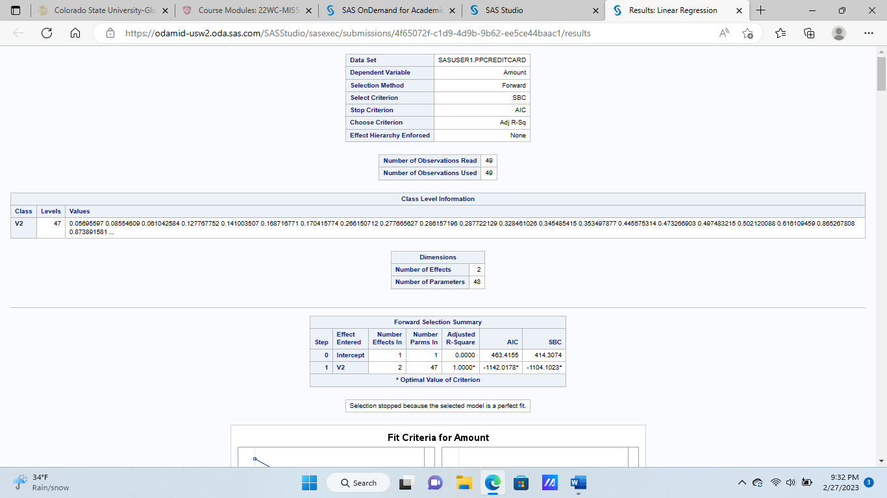
FINDINGS

Slide 20
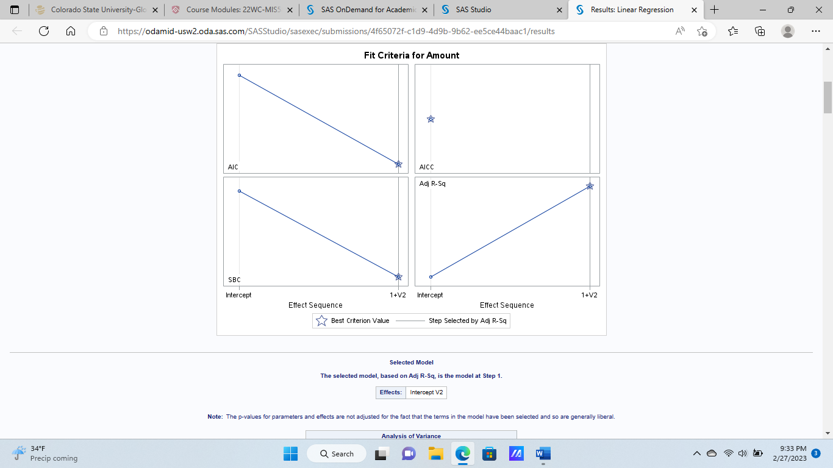
Findings

Slide 21
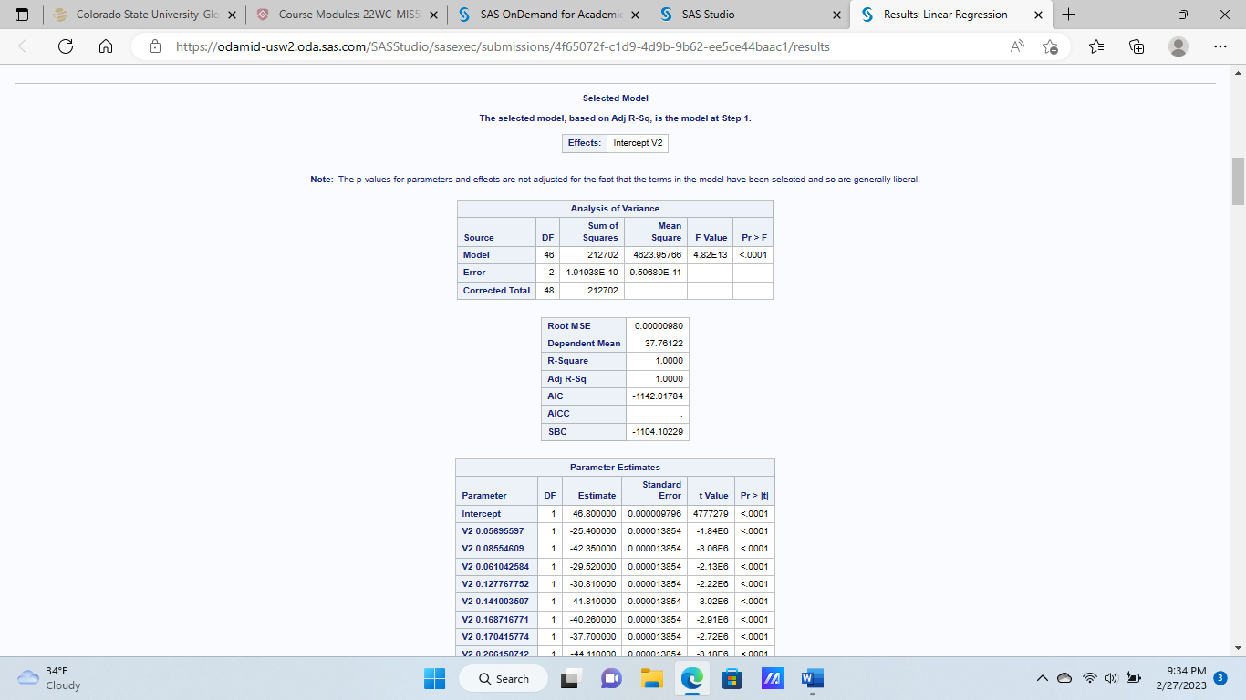
Findings

Slide 22
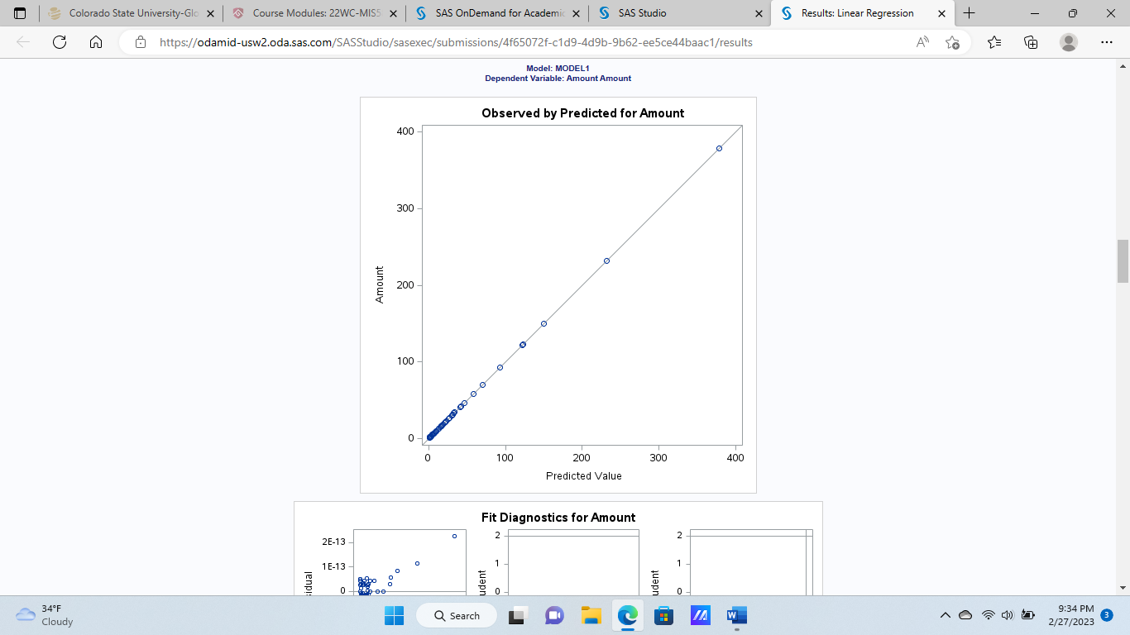
Findings

Slide 23
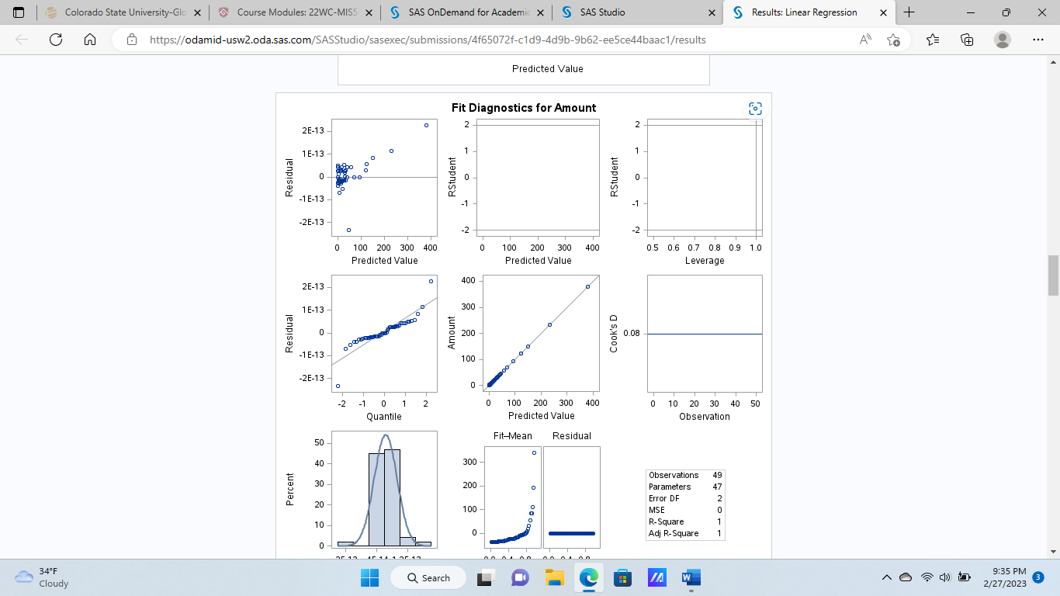
Findings

Slide 24
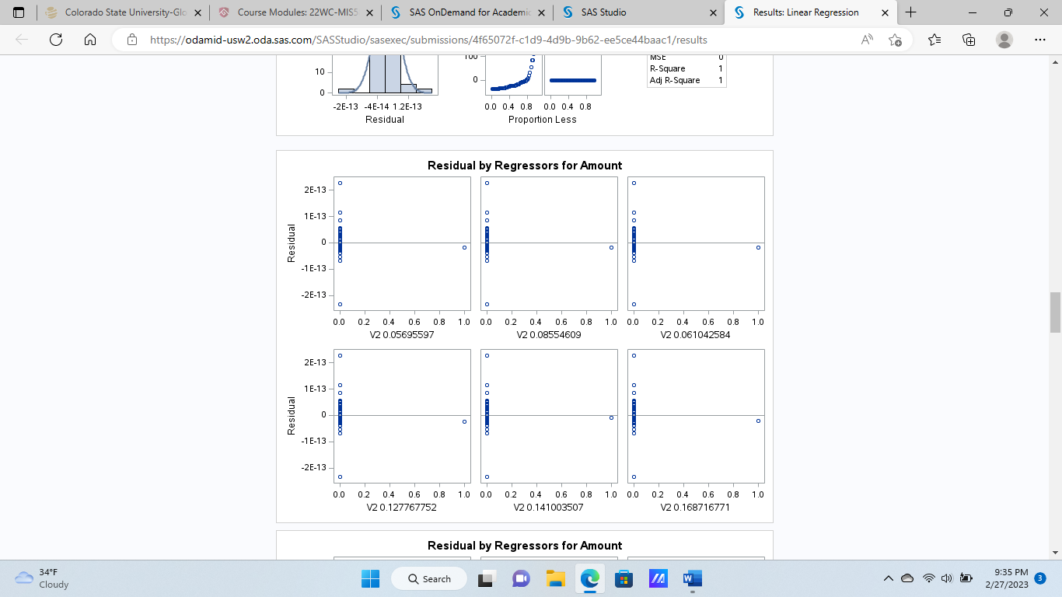
Findings

Slide 25

Findings

Slide 26
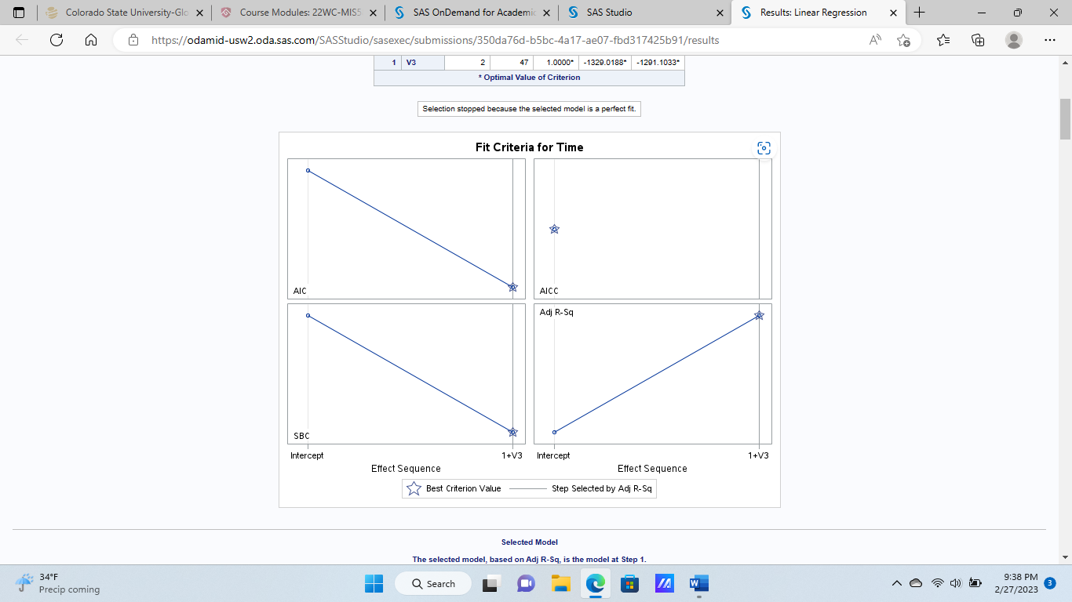
Findings

Slide 27
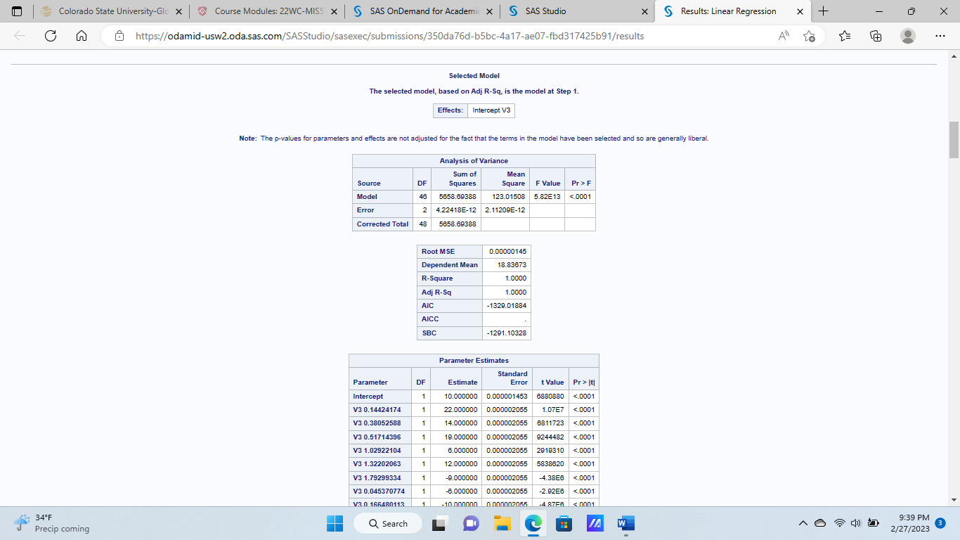
Findings

Slide 28
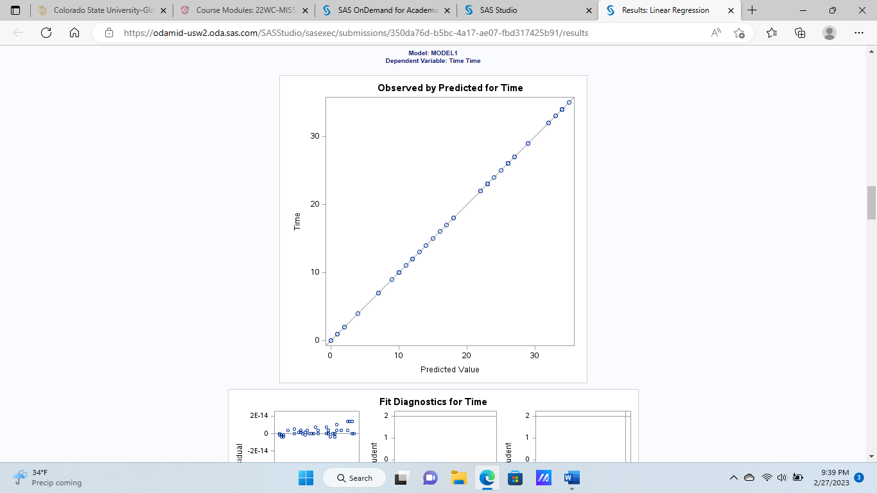
Findings

Slide 29
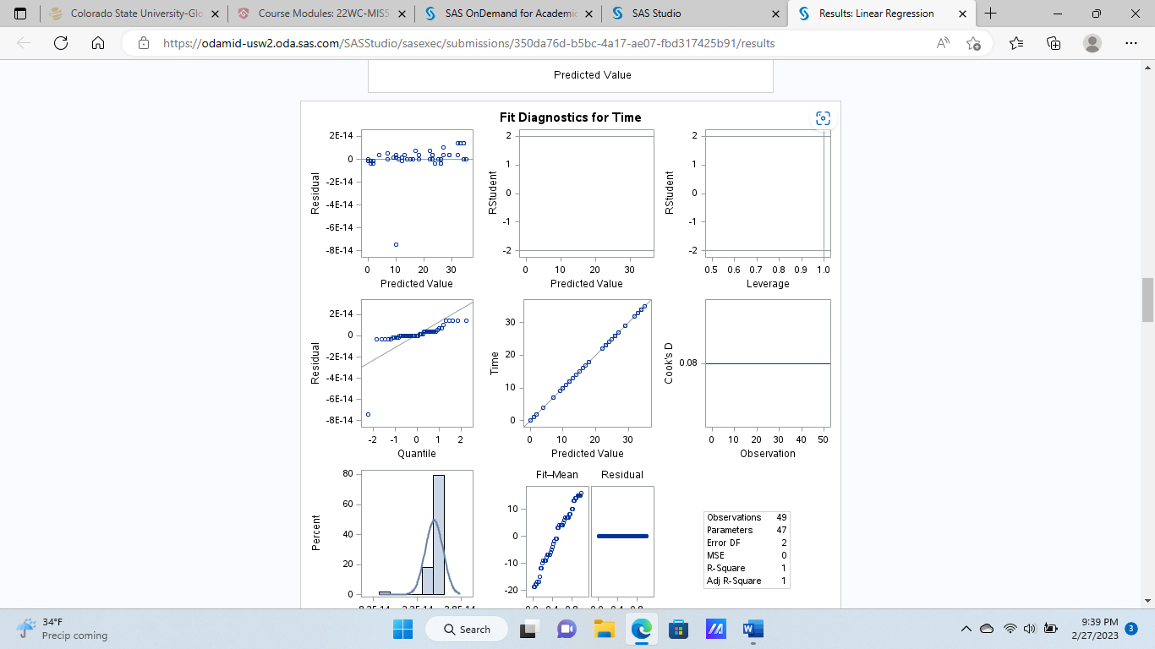
Findings

Slide 30
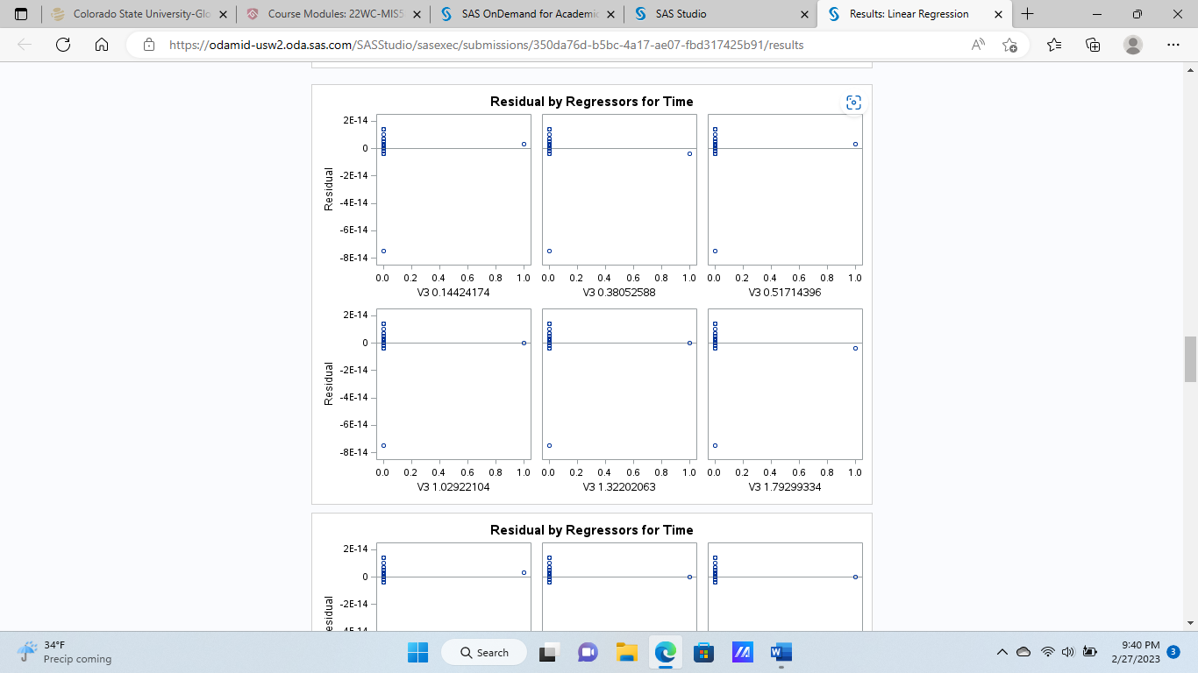
Findings

Slide 31
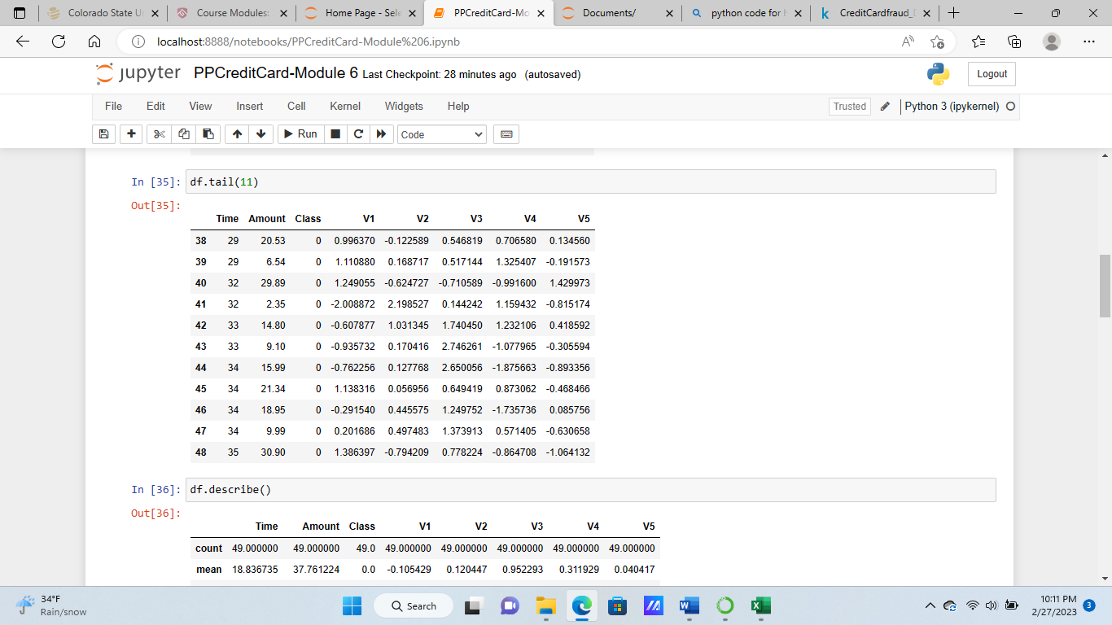
Findings

Slide 32
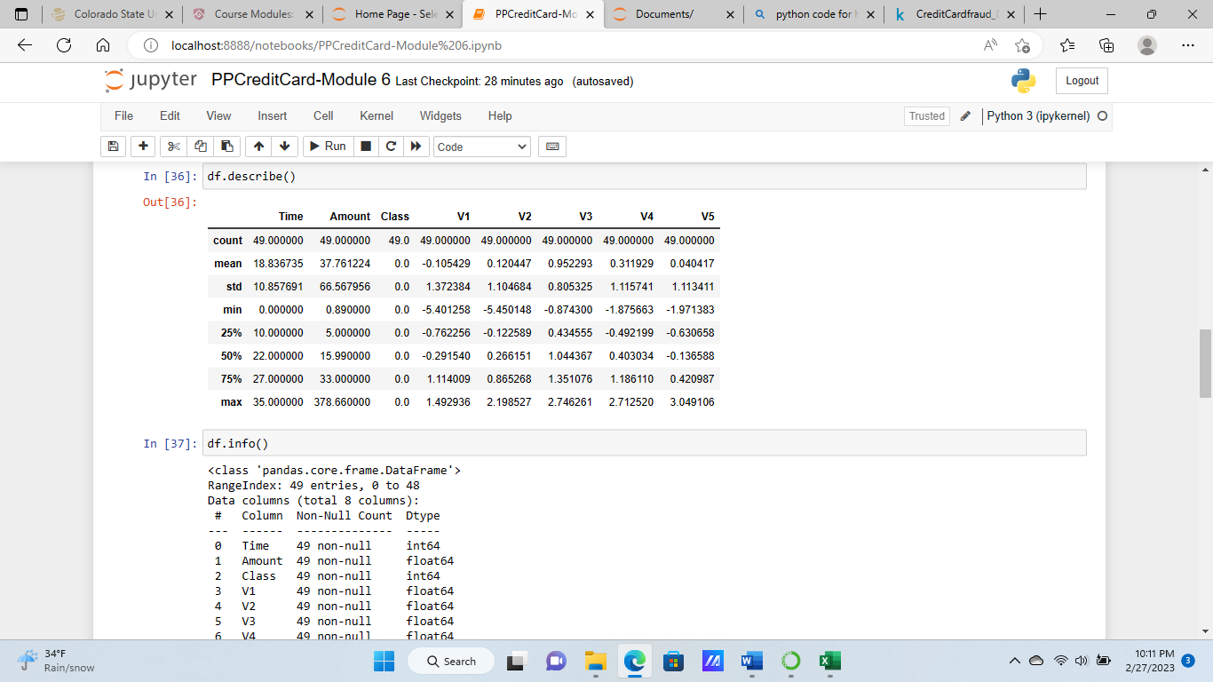
Findings

Slide 33
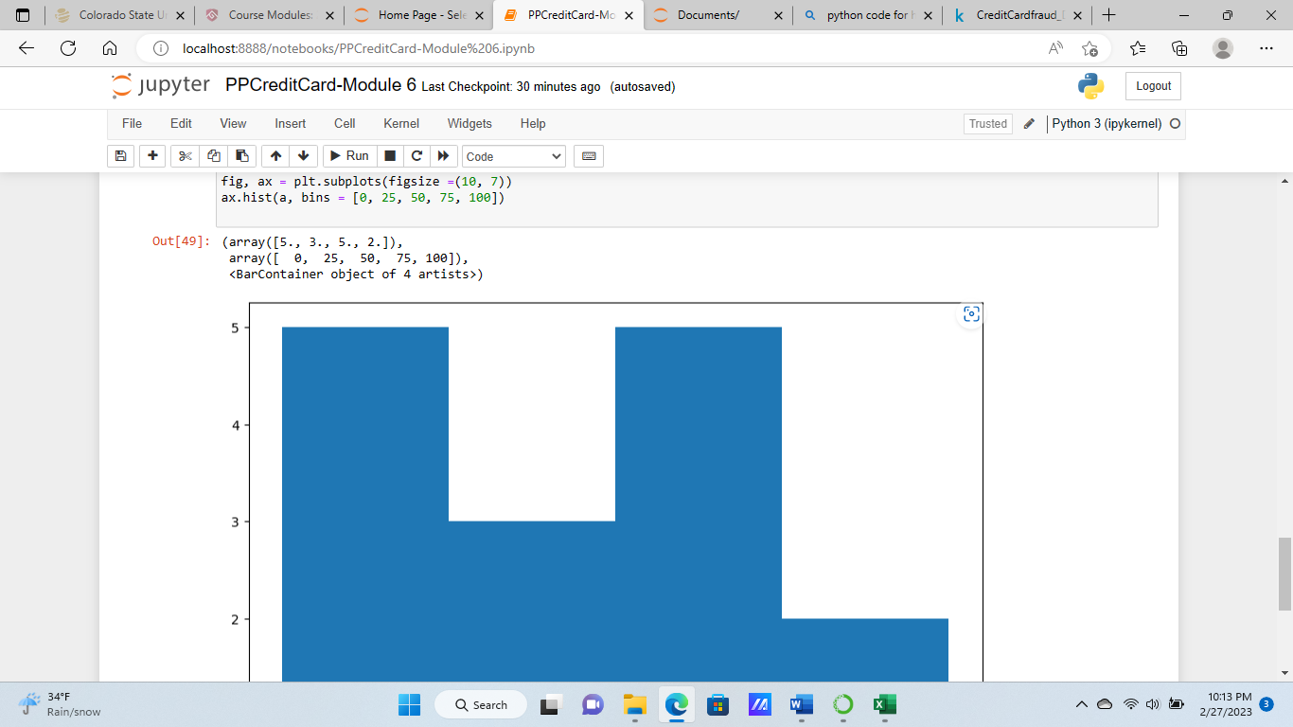
Findings

Slide 34
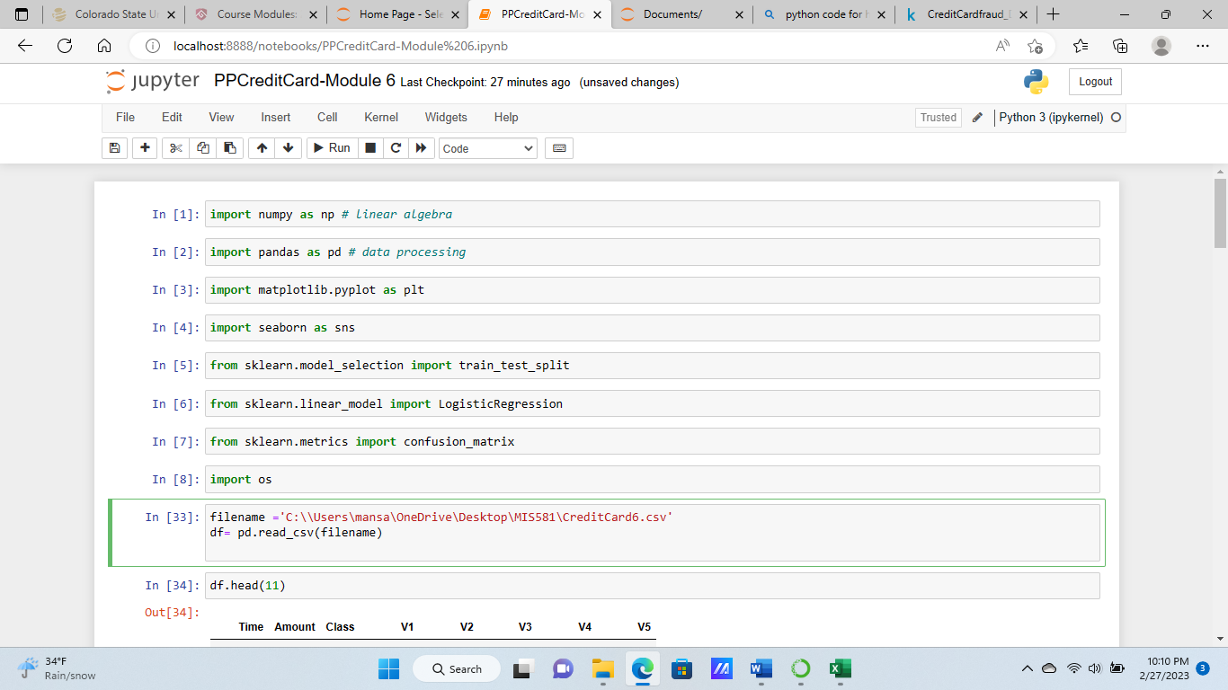
Findings

Slide 35
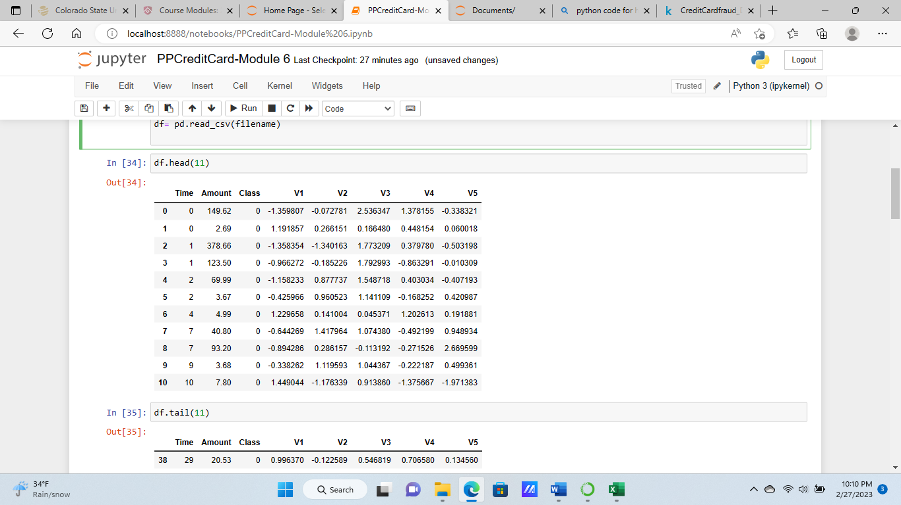
Findings

Slide 36
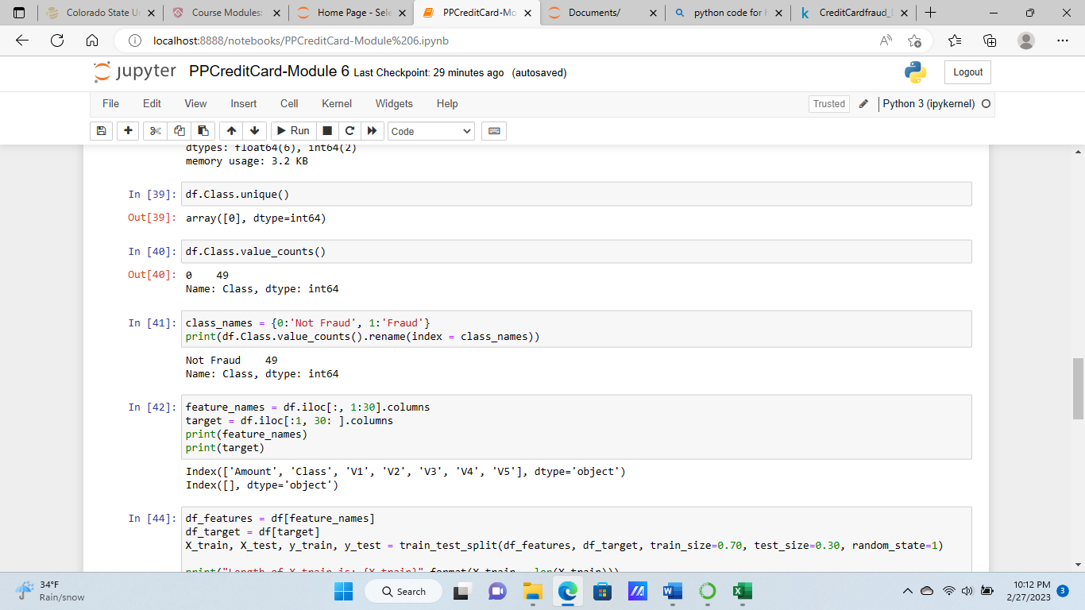
Findings

Slide 37
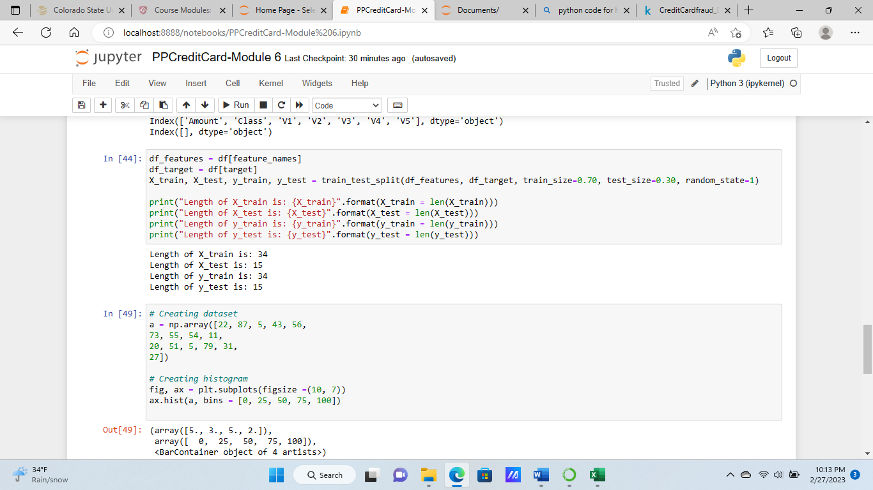
Findings

Slide 38
Findings
For this section we have included histograms and box plots to show the correlation among the business questions. We have found that the statistical nature of our variables show that they are statistically significant because the p-value is below .05. We can reject the null hypothesis and accept the alternative hypothesis.

Slide 39
CONCLUSION (Due in Week Six)
In conclusion, we used Statistical Analytic Software to perform a linear regression among the business questions and variables. We found that the correlations among the variables were statistically significant. We can see from our findings that there is a relationship between amount and V2 and time and V3. We also used Python to describe our dataset and provide a summary statistic of our credit card dataset.

Slide 40
Recommendations
I would recommend utilizing business analytics which includes operational analytics, tactical analytics, and strategic analytics. Many companies use analytics to better understand their services and products with the market. Some of the statistical techniques consist of predictive analytics to forecast the results and explore the data. Also, analytics can be monitored by answering what occurred in the past to real-time analytics regarding what is occurring presently. Subject matter analytics can be useful for particular types of data such as credit card fraud (CSU-Global, 2023).

Slide 41
References
REFERENCES
Advancing Technology for Humanity. (2023). IEEE Code of Ethics. IEEE.
IEEE - IEEE Code of Ethics
CSU-Global. (2023). 4.3 Conducting Literature Review to Support Data Analysis. Interactive Canvas.
Conducting Literature Review to Support Data Analysis: 22WC-MIS581-1 (instructure.com)
CSU-Global. (2022). 5.3 Best Practices for Acquiring Data for Data Analytics Projects. Interactive Canvas.
5.3 Best Practices for Acquiring Data for Data Analytics Projects: 22WC-MIS581-1 (instructure.com)
Data Flair. (2023). Credit Card Fraud Detection with Python & Machine Learning. Data Flair.
Credit Card Fraud Detection with Python & Machine Learning - DataFlair (data-flair.training)
GeeksforGeeks. (2022). Exploratory Data Analysis in Python. GeeksforGeeks.
Exploratory Data Analysis in Python - GeeksforGeeks
Harzog, B. (2021). The very best ways to prevent credit card fraud. U.S. News.
The Very Best Ways to Prevent Credit Card Fraud | Credit Cards | U.S. News (usnews.com)

Slide 42
References
Kaggle. (2023). Credit Card Fraud Detection. Kaggle.
Credit Card Fraud Detection | Kaggle
Karp, G. (2022). How to Prevent Credit Card Fraud. NerdWallet.
How to Prevent Credit Card Fraud - NerdWallet
O’Reilly (2022). Limitations and Weaknesses. O’Reilly.
Limitations and Weaknesses - Data Analysis Plans: A Blueprint for Success Using SAS [Book] (oreilly.com)
Radonic, D. (2023). 21+ Concerning Credit Card Fraud Statistics for 2022. Moneyzine.
21+ Concerning Credit Card Fraud Statistics for 2022 | Moneyzine.com
Stevens, E. (2022). Quantitative vs Qualitative Data: What’s the Difference? CF Blog.
Quantitative vs Qualitative Data: What’s the Difference? (careerfoundry.com)
White, A. (2022). Here’s how credit card fraud happens and tips to protect yourself. CNBC.
Credit Card Fraud: How It Happens and How to Protect Yourself (cnbc.com)

Slide 43
MIS581: Self-Evaluation Form
MIS581: Self-Evaluation Form
Name: Nida Ansari
Title/Topic of Speech: Portfolio Project (Credit Card Fraud)
Please answer the following questions in detail (meaning a minimum of two complete sentences per question). Feel free to type your answers after the questions below. Your completed self-evaluation should be uploaded to the Week 1 Capstone Milestone page for the self-introduction speech and to the Week 8 Capstone Project page for the final assignment.
How well did you believe that you explained and supported your ideas?
I believe that I explained and supported my ideas well.
Did you state your purpose and speaking topic? I stated my purpose and speaking topic.
Did you state your thesis?
I have stated my thesis.
How effective was your introduction? Very Effective.
Did you preview your main points?
Yes I previewed my main points.
How effectively did you use transitions? I effectively used transitions.
Did you provide adequate nonverbal support?
Yes I provided appropriate nonverbal support.
Did you use visual aids?
Yes I provided visual aids.
Did you cue for closure?
Yes I cued for closure.
Did you restate your thesis and main points? Yes
Looking over your Microsoft Office Presenter Coach report, what were your areas of strength? What areas do you need to work on? How do you plan to address these areas?

